Slide 1
Introducing
Cisco Networking Academy
Richard Grotegut
Western Academy Support & Training Center (WASTC) Director Deputy Sector Navigator IT/CS Diablo Valley College
Notes:
Presentation Title:
Introducing Cisco Networking Academy
Presentation Content:
Provides a detailed overview of Networking Academy, including key messages and information about the program, offerings, and need for ICT/Networking skills
Target Audience:
Prospective academies or partners, government officials, educators, etc.
Content Date:
Last updated in Oct 2012 for US/Canada GEO
Presentation Tips:
Please tailor this presentation to your goals, audience, and time constraints
Notes are provided in this presentation to identify key speaking points and provide additional background
As some of the slides are animated, this presentation is best viewed in slideshow mode
Backup slides are optional

Slide 2
ICT Skills Are Needed Everywhere
ICT and networking careers exist in every industry: financial services, fashion, entertainment, healthcare, and more
Virtually no limits — nearly every organization relies on ICT for success
Television
Entertainment
Education
Gaming
Green Tech
Healthcare
Gov’t/Finance
Security
Notes:
Skills learned in Networking Academy courses can lay a powerful foundation for almost any profession—even non-ICT fields
There are virtually no limits because today nearly every company in every industry relies on IT

Slide 3
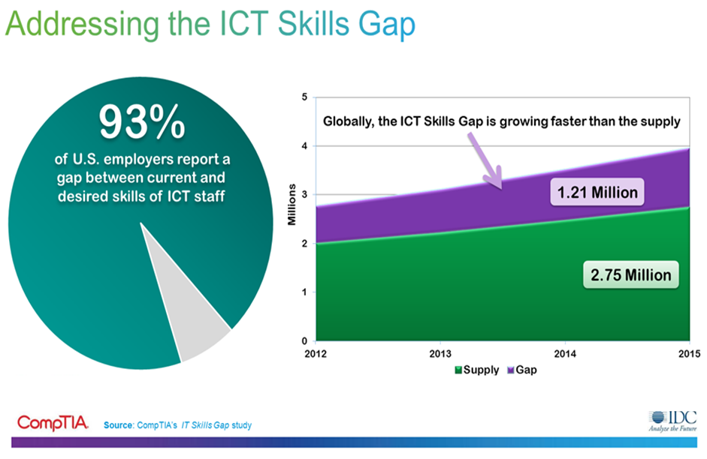

Slide 4

What Networking Academy Provides
A Turnkey Solution for Educators
High quality curriculum and learning tools
  Free to nonprofit educational institutions
Discounts on Cisco equipment and certification exams
State-of-the-art online assessments
  Quizzes, simulation skills exams, chapter and final exams
Learning management system
  Classroom management, grade book, teaching resources
Instructor training and ongoing professional development
24x7 online support
Online instructor collaboration communities
Student resources and alumni program
Notes:
The Cisco Networking Academy Program can help your organization prepare students for meaningful careers.
High quality curricula and innovative learning tools prepare students for several career paths as well as industry-recognized certifications, a passport to the job market.
Created by educators, for educators, Cisco offers the curriculum at no cost to not-for-profit educational institutions.
More than 10,000 Academies are using the assessment and gradebook tools that are embedded in the program.
More than 20,000 instructors tap into online support and Academy training for professional and personal development.
The Alumni program helps your organization connect students and graduates to work opportunities.

Slide 5



What Your Organization Provides
To Become an Academy
Classroom space for in-person instruction
Instructor available to receive training
Funds to purchase lab equipment bundles (varies by curriculum)
Student PCs for viewing online curricula and labs
Internet access with sufficient network connections and bandwidth
Notes:
Eligible organizations include secondary schools, community colleges, universities, and other institutions with education as a mission.
Academies commit space and people to the program in exchange for access to the curriculum, equipment discounts, and instructor support.
Instructors must attend training sessions and pass certification exams ahead of their students.
Academies have a dedicated lab where students can review curriculum and perform hands-on exercises with lab equipment.
Funds available to purchase the appropriate lab equipment curriculum bundle(s)
At least a 3:1 student to computer ratio (1:1 is preferred) recommended in the lab with sufficient network connections
Academies are responsible for marketing and recruiting students.

Slide 6
Comprehensive Learning Experience

Slide 7
Networking Academy Offerings
PC computer hardware and software
CompTIA A+ certification
Basic routing, switching, and WAN
CCENT certification
Intro to ICT & networking in healthcare industry
Advanced routing, switching, and WAN
CCNA R&S certification
Network security concepts
CCNA Security certification
Advanced networking for converged networks
CCNP certification
ICT & Networking Skills
Business & Soft Skills
21st Century Skills
CCNA Routing and Switching (Courses 1 & 2)
Health Information Networking
CCNA Routing and Switching (Courses 3 & 4)
IT Essentials
CCNA Security
CCNP
Aspire – Simulation-Based Learning Game
Passport21 – Entrepreneurship Case Studies
Assessments – Technology-Enabled Summative, Formative, and Simulation-Based Exams
Packet Tracer – Multi-User Simulation and Visualization Tool
Cisco NetSpace – Cloud-Based Learning and Collaboration Platform
Notes:
Our current portfolio consists of 10 courses
IT Essentials — covers the fundamentals of computer hardware and software and advanced concepts such as security, networks, and the responsibilities of an IT professional.
CCNA Routing & Switching (Courses 1 & 2) — provides basic routing, switching, and WAN knowledge
Health Information Networking (HIN) — helps students prepare for networking careers in the healthcare industry.
CCNA Routing and Switching (Courses 3 & 4) — provides an introduction to networking and helps students develop foundational routing, switching, and WAN knowledge and experience, which can be applied toward Cisco certifications, entry-level careers and to help students succeed in networking-related degree programs and a range of professions.
CCNA Security — helps students develop a comprehensive understanding of network security concepts, and gain the knowledge and skills needed to earn the Cisco CCNA Security certification and become entry-level security specialists.
CCNP (3 courses) — the CCNP curriculum focuses on the advanced routing, secure wide area access, multilayer switching, and networking management skills required to implement and maintain converged enterprise networks.
Assessments
Innovative online assessments provide immediate feedback to help students and instructors evaluate acquired knowledge and skills.
Simulation-Based Learning
Cisco Packet Tracer provides a simulation-based learning environment that supplements physical equipment with virtual networks and helps students develop critical 21st century skills. Cisco Packet Tracer is a foundational teaching tool for CCNA Routing and Switching, with Packet Tracer activities embedded in the course content. Interactive learning promotes the exploration of networking concepts and experimentation with tools such as Packet Tracer and Flash-based activities to help students develop a greater understanding of networking technologies. Packet Tracer activities are also available for IT Essentials, HIN, and CCNA Security.
Gaming in Education
By integrating aspects of gaming such as virtual worlds, competition, scoring, and challenge levels into the curricula and teaching tools such as the Cisco Aspire game, students feel they are playing, not studying.
Entrepreneurial Skills
Passport21 to Entrepreneurship exposes students to entrepreneurship opportunities in networking scenarios through a series of case studies and Cisco Packet Tracer activities that help students develop critical business and financial skills
Cisco NetSpace
Our online learning environment combines best-of-breed cloud-based applications for teaching, learning, and collaboration, to enable an interactive and engaging learning experience that aligns with the latest educational models, trends, and best practices.
7

Slide 8
Curriculum Alignment to Certifications
Certifications
CompTIA
A+
CCENT
CCNA Routing and Switching
CCNA
Security
CCNP
CCNA Routing and Switching (Courses 1 & 2)
CCNA Routing and Switching
IT Essentials
CCNA Discovery
CCNA Security
CCNP
Student Networking Knowledge and Skills
Notes:
Our curricula help prepare students for industry recognized certifications:
IT Essentials — CompTIA A+ certification
CCNA Routing and Switching (first 2 courses) — CCENT certification
CCNA Routing and Switching (4 courses) — CCNA certification
CCNA Security — CCNA Security certification
CCNP (3 courses) — CCNP certification

Slide 9
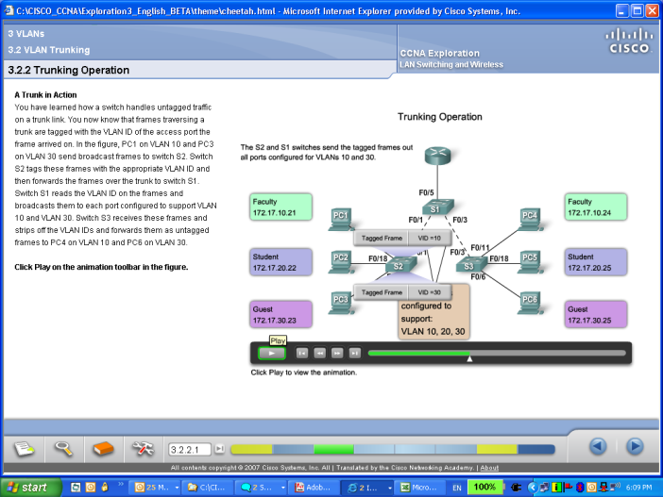
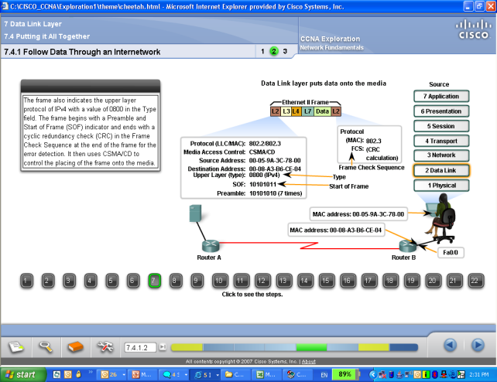
Online Curricula
Courses with Embedded Rich Media Learning Activities
Notes:
Curricula and supporting instructor teaching resources are available online through Academy Connection (our learning management system), providing easy access and ensuring a consistent learning experience around the world
The online courses encourage the sort of e-learning and interactivity that engages today’s students, and also lend themselves to cutting-edge pedagogical methods and tools such as simulations and individualized feedback.

Slide 10

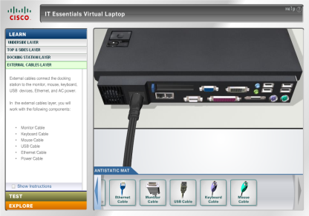
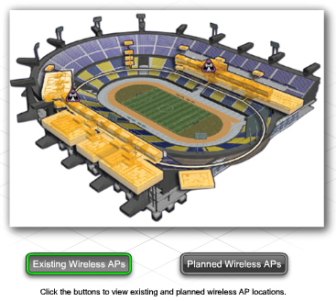
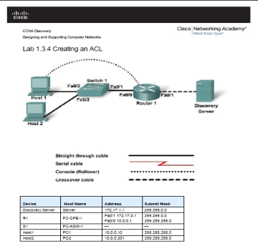
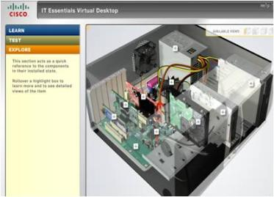
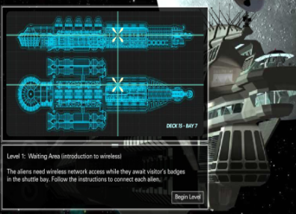
Hands-on Labs and Interactive Activities
Practical Application of Learned Skills
Integrated into the Online Curricula
Notes:
Students complete hands-on labs and interactive learning activities to develop practical skills that will help them fill a growing need for networking professionals around the world.

Slide 11

The World’s Largest Classroom
Impact since 1997
Countries
170
Instructors worldwide
20,000
Students worldwide
5 Million
Online exams taken
143 Million
Academy schools worldwide
9,500
Languages offered
19
Over 1 Million Current Students!
Notes:
Since its start in 1997 as a small-scale effort to help local schools get the best use from their networking equipment, the Networking Academy program has grown to more than 9,000 academies in 170 countries.
This year alone, 20,000 instructors are teaching 1 million students globally, and there have been over 5 million students enrolled globally since 1997.
Our state of the art online assessment system delivers 1 million online exams every month, and over 100 million exams have been taken to date.
Courses are available in multiple languages (varies by curriculum).
We have succeeded in scaling to this size, while still being able to give our offerings a local face and maintain control and quality, by taking advantage of networking technology.
Consistent yet flexible content is easily extended to diverse student populations, and instructors can adapt it to the local educational institution and community.
Network-based applications are a chief contributor to the program’s scalability:
Course adoption can occur more quickly.
Academies can be up and running in the time it takes to train instructors and obtain equipment.
Course content can be created, packaged for large audiences, and revised with greater speed and ease.
And colleagues in distant locations can collaborate without the need to travel.

Slide 12

What Does This Mean for your Students?
Teaches students how to design, build, troubleshoot, and secure computer networks
ICT skills and knowledge for students looking to gain a competitive edge
Provides a clear and direct pathway to a career
Engages them in a 21st Century Education Model
Virtually no limits — nearly every organization relies on ICT for success
A standards-based curriculum

Slide 13
California ICT Pathways, State CTE Model Curriculum Standards and
Internet Engineering & Cybersecurity
Richard Grotegut, Deputy Sector Navigator Bay Region, Director, WASTC

Slide 14
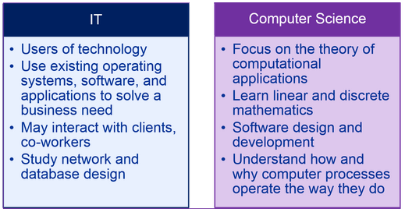
IT versus Computer Science

Slide 15
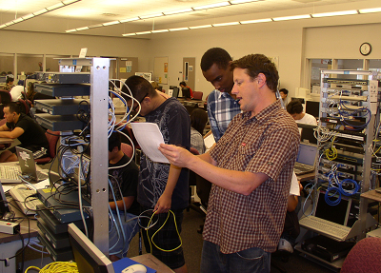

IT/Cybersecurity Pathways and the Cisco Academy Program
Building the Pathway

Slide 16
Cisco Academy High School Curriculum
Certifications
CompTIA
A+
CCENT
CCNA Discovery
IT Essentials
CCNA Routing and Switching
CCNA1 and CCNA2
Student Networking Knowledge and Skills
Notes:
Our curricula help prepare students for industry recognized certifications:
IT Essentials — CompTIA A+ certification
CCNA Routing and Switching (first 2 courses) — CCENT certification
CCNA Routing and Switching (4 courses) — CCNA certification
CCNA Security — CCNA Security certification
CCNP (3 courses) — CCNP certification

Slide 17
Four-Year Pathway Program
Middle School Outreach
9th Grade Introduction to Computers/Technology
10th Grade Cybersecurity ICT Essentials – Cisco IT Essentials (A+)
11th Grade Internet Engineering I – Computer Introduction to Networks (CCNA1)
12th Grade Internet Engineering II – Routing and Switching Essentials (CCNA2)

Slide 18


Slide 19
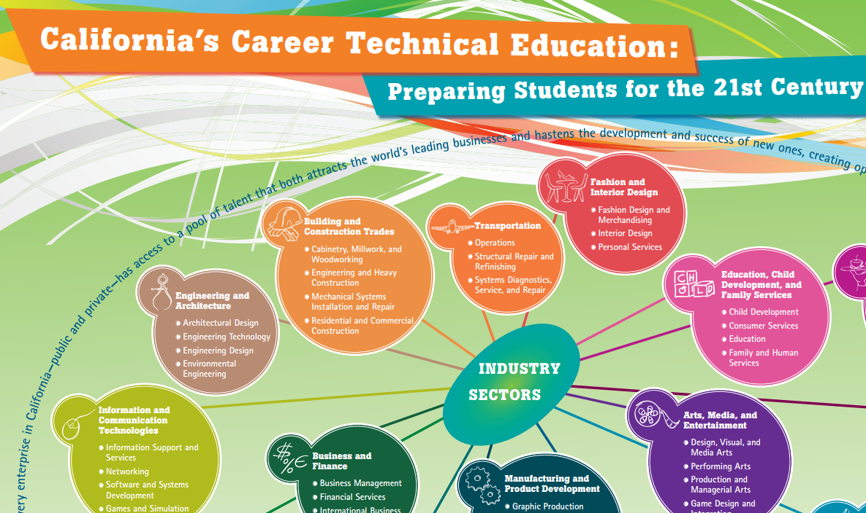

Slide 20

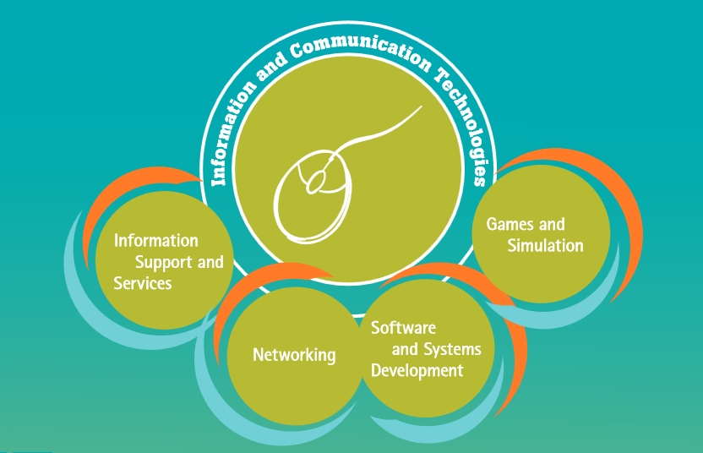

Slide 21
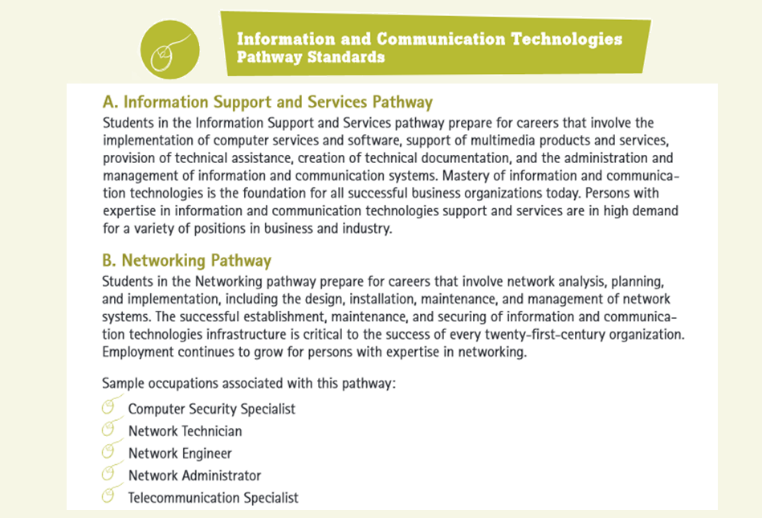

Slide 22

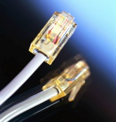

ICT Support and Services Pathway
Networking Pathway
Software and Systems Development Pathway
Games and Simulations
The new California CTE Model Curriculum Standards

Slide 23

ICT Support and Services Pathway
Networking Pathway
Software and Systems Development Pathway
Games and Simulations
Align with the new California CTE Model Curriculum Standards
IT Essentials
IE1 (CCNA1) and IE2 (CCNA2)

Slide 24
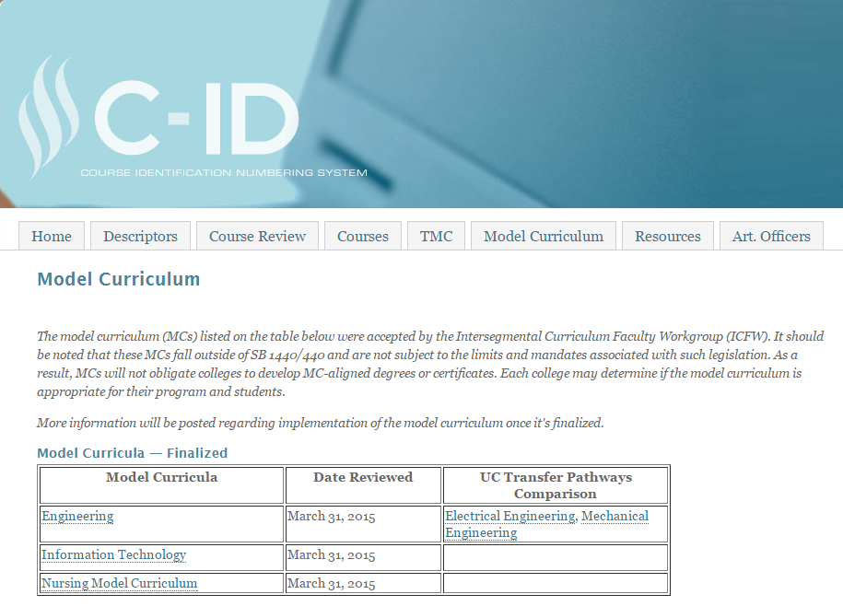
Community College Model Curriculum
Notes:
C-ID process and Transfer Model Curriculum

Slide 25
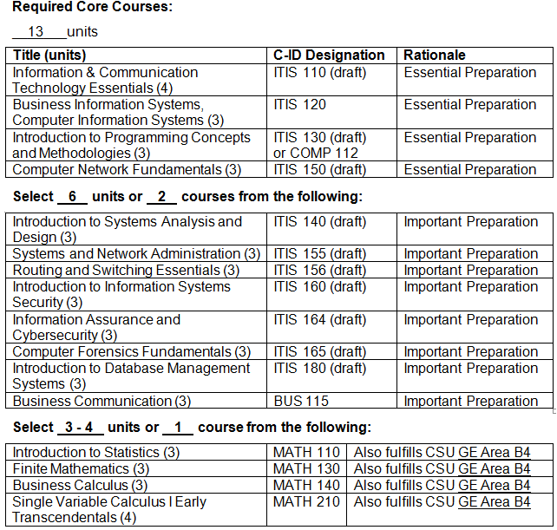
IT - Model Curriculum
Notes:
Resulting ICT Model Curriculum Developed

Slide 26
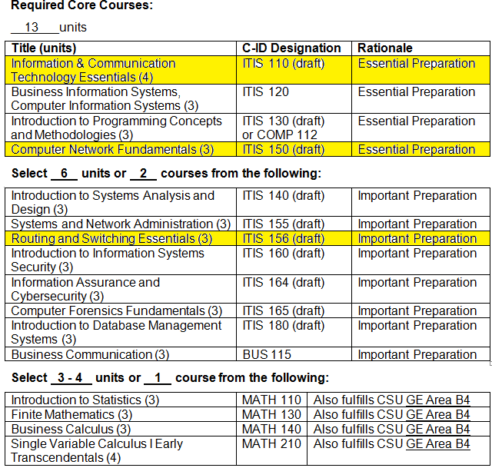
IT - Model Curriculum
IT Essentials
CCNA 1
CCNA 2
Notes:
Resulting ICT Model Curriculum Developed

Slide 27
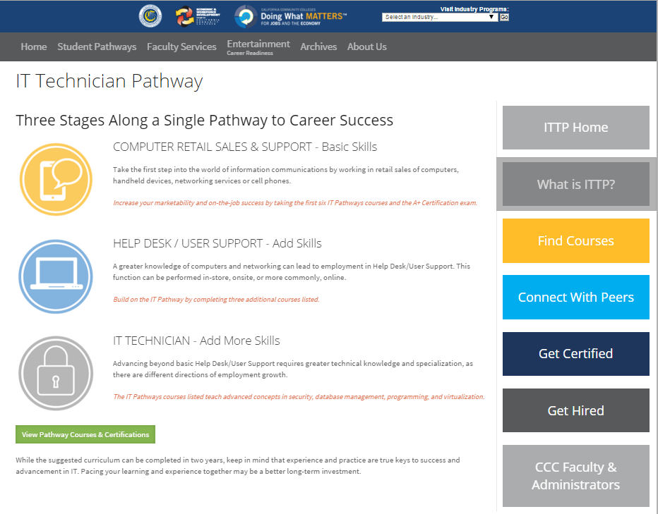

Slide 28
IT Technician Pathway (ITTP)

Slide 29

High School Curriculum
Certifications
CompTIA
A+
CCENT
Knowledge and Skills for the Cyberpatriot Competition
CCNA Routing and Switching (Courses 1 & 2)
IT Essentials
CCNA Discovery
Student Networking Knowledge and Skills
Notes:
Our curricula help prepare students for industry recognized certifications:
IT Essentials — CompTIA A+ certification
CCNA Routing and Switching (first 2 courses) — CCENT certification
CCNA Routing and Switching (4 courses) — CCNA certification
CCNA Security — CCNA Security certification
CCNP (3 courses) — CCNP certification

Slide 30

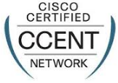
Four-Year Pathway Program
9th Grade Introduction to Computers/Technology
10th Grade Cybersecurity ICT Essentials – Cisco IT Essentials (CompTIA A+ certification)
11th Grade Internet Engineering I – Computer Introduction to Networks
12th Grade Internet Engineering II – Routing and Switching Essentials (CCENT Certification)
A-G

Slide 31

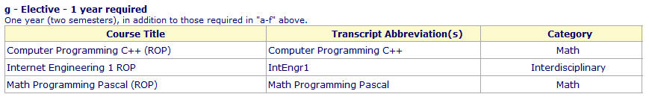
A-G designation

Slide 32
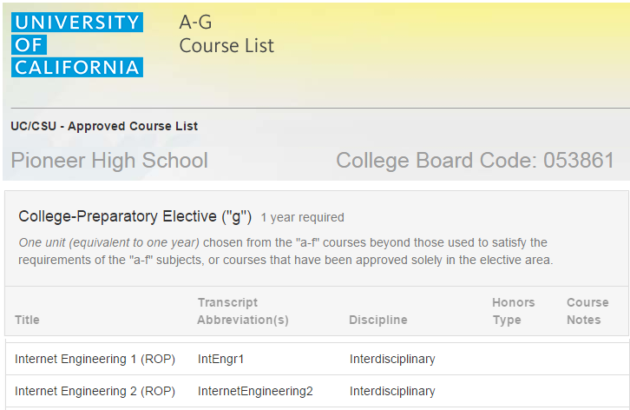

Slide 33
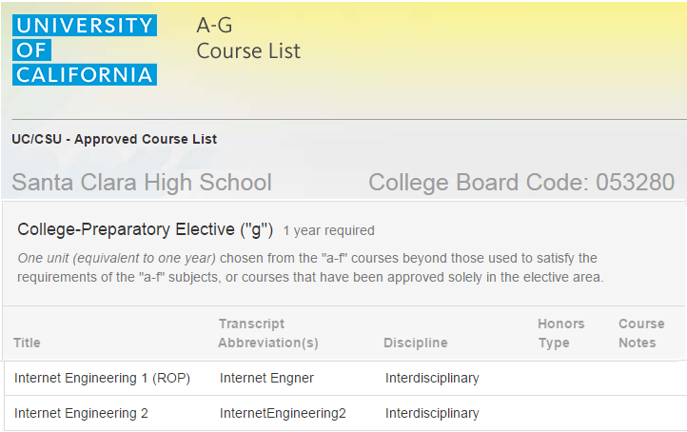

Slide 34
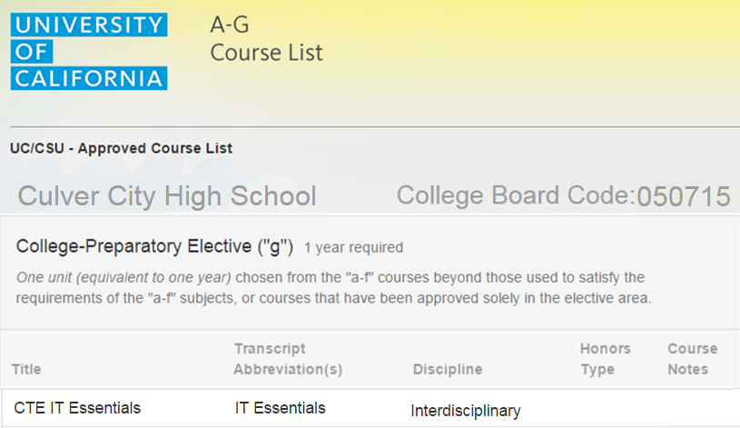

Slide 35
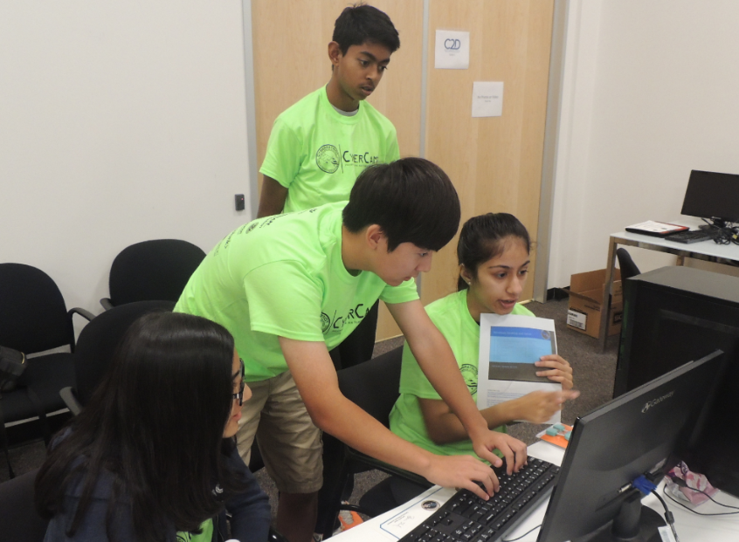
Cyberpatriots and the Cisco Academy Program
Building the Pathway

Slide 36
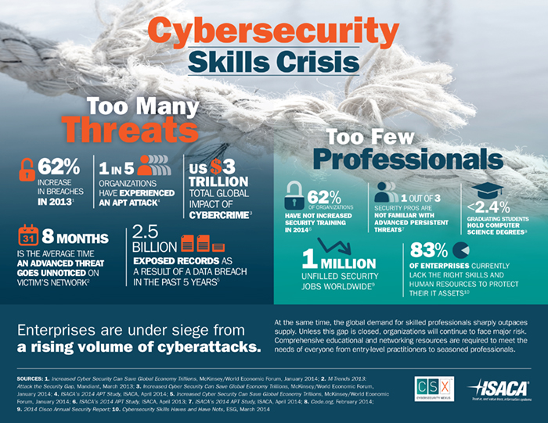

Slide 37
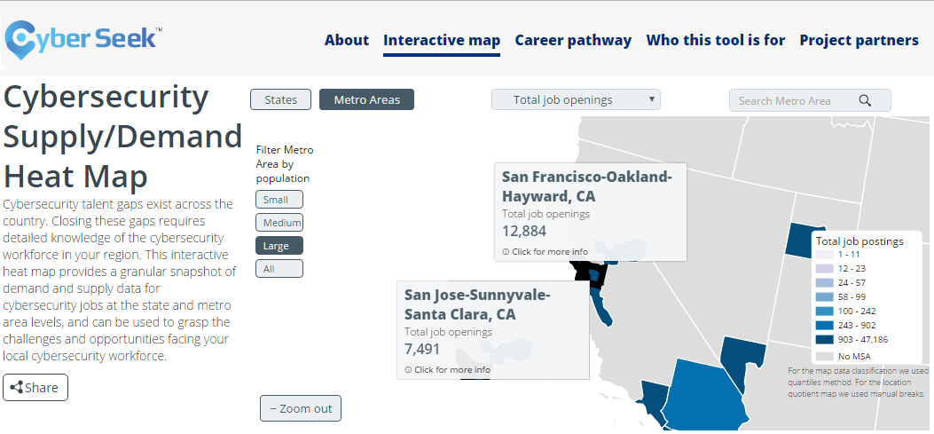
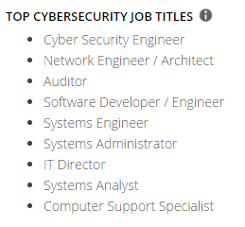
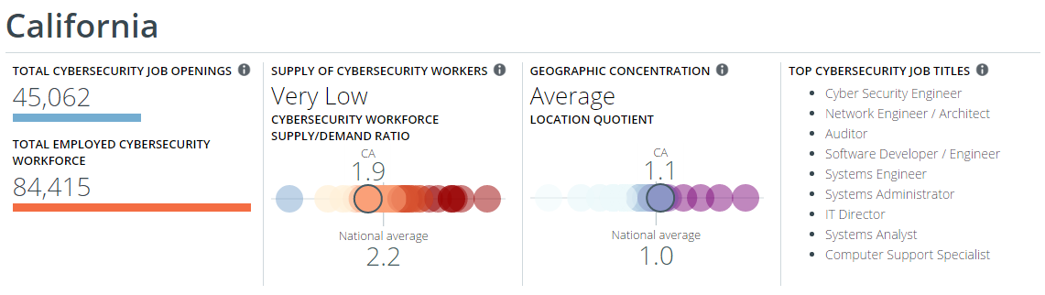

Slide 38
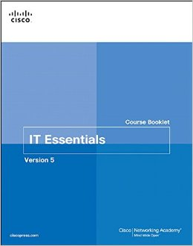
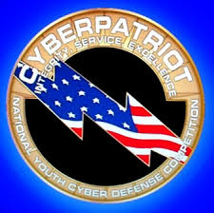
IT-Essentials and Cyberpatriots

Slide 39
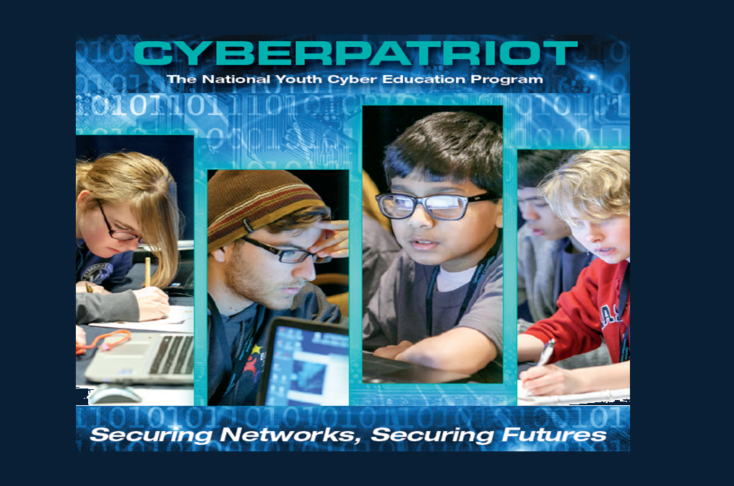

Slide 40
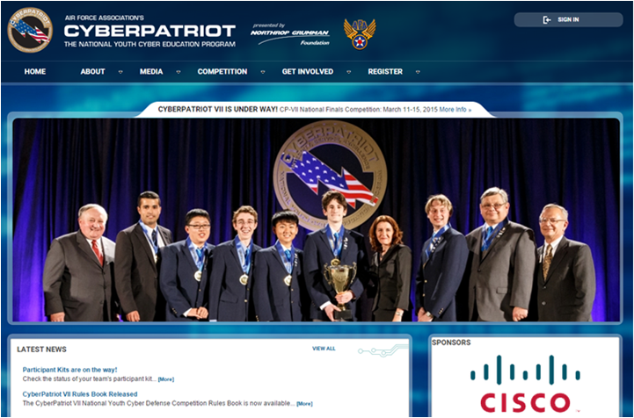

Slide 41
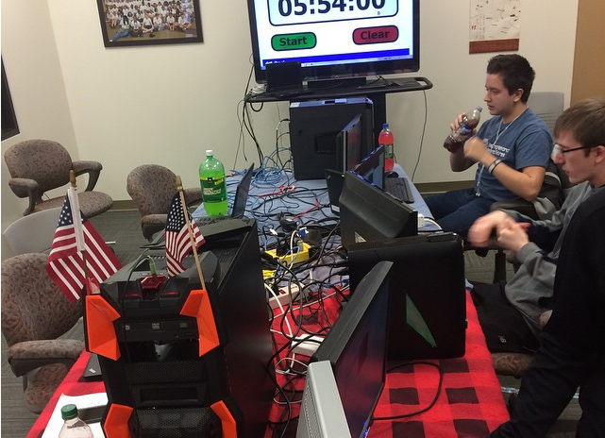
Cyberpatriot Competition
#CyberPatriot #Nationals #Team404

Slide 42
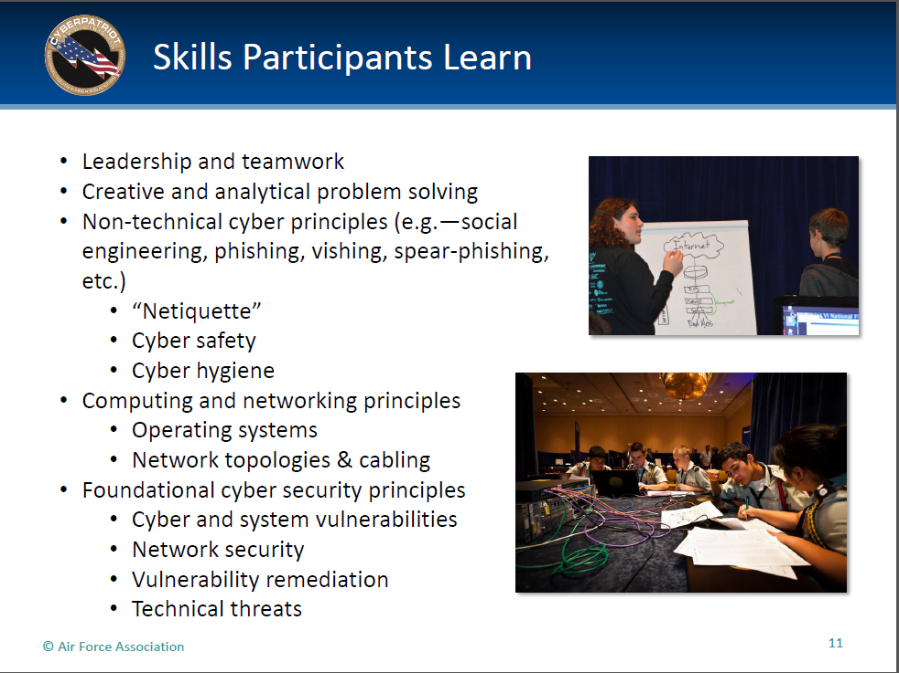

Slide 43
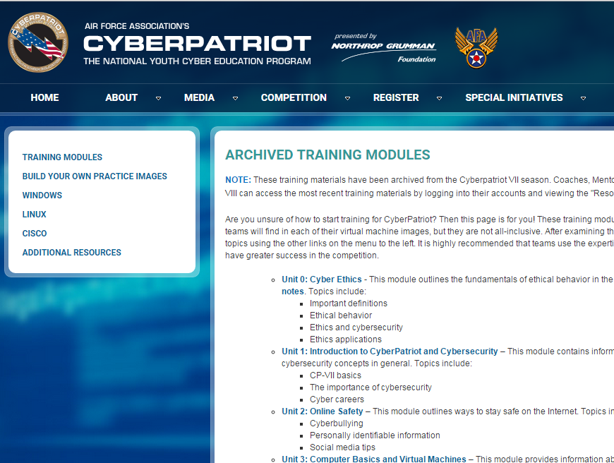

Slide 44
AKA Networking

Slide 45
Pathway - Cybersecurity
9th Grade – Digital Literacy (Cybersecurity 1.1)
Begin Competing in Cyberpatriots
10th Grade – Cybersecurity ICT Essentials (A+)
11th Grade - Internet Engineering I (CCNA1)
12th Grade - Internet Engineering II (CCNA2)
include Linux Essentials (10-12)
Compete in Cyberpatriots all four years

Slide 46
Community College Outreach
Building the Pathway

Slide 47
Dual Enrollment – opportunities
9th Grade Introduction to ICT – ITIS-120 Computer Information Systems (3 units)
10th Grade A+ Course – ITIS-110 Information & Communication Technology Essentials (4 units)
11th Grade Internet Engineering I – ITIS-150 Computer Network Fundamentals (3 units) (CCNA1)
12th Grade Internet Engineering II – ITIS-151 Routing and Switching Essentials (3 units) (CCNA2)
A-G

Slide 48


Dual Enrollment - advantages
Shared apportionment.
High School teacher serves a college adjunct faculty
Students earn credit directly from the college – no articulation.
Provide your high school students with all of the college ICT program benefits:
  Microsoft Dreamspark – free software
  Certification Vouchers – deep discounts
  BACCC ICT Shared Remote Lab access

Slide 49


BACCC NETLAB+ Update/Vision
BACCC Shared ICT Remote Lab Project – 2016/17

Slide 50
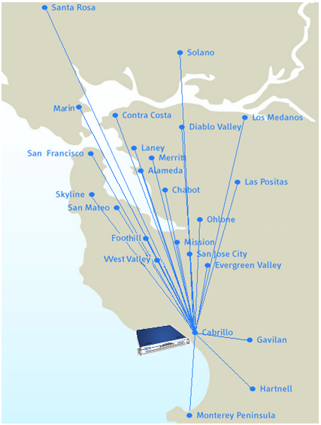
Participating Colleges
Las Positas College
Los Medanos College
Merritt College
Mission College
Monterey Peninsula
Ohlone College
San Jose City College
San Mateo College
Santa Rosa College
Skyline College
Solano College
West Valley College
Cabrillo College
Chabot College
CCSF
College of Alameda
College of Marin
Contra Costa College
Diablo Valley College
Evergreen College
Foothill College
Gavilan College
Hartnell College
Laney College
Notes:
50

Slide 51

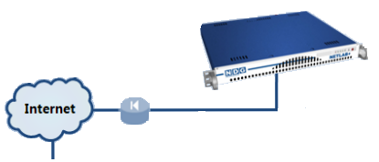
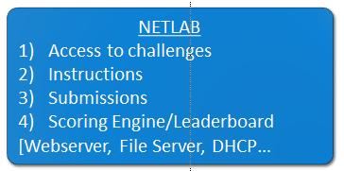
Support for Cyberpatriots
Leaderboard
Admin
BYODOD
5 systems provided (SIFT)

Slide 52
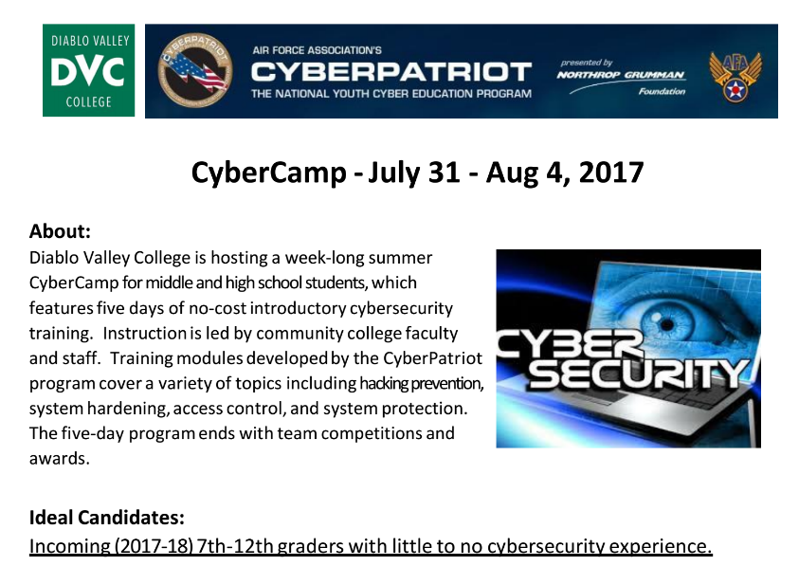
Bay Area Summer Cyber Camp Schedule

Slide 53
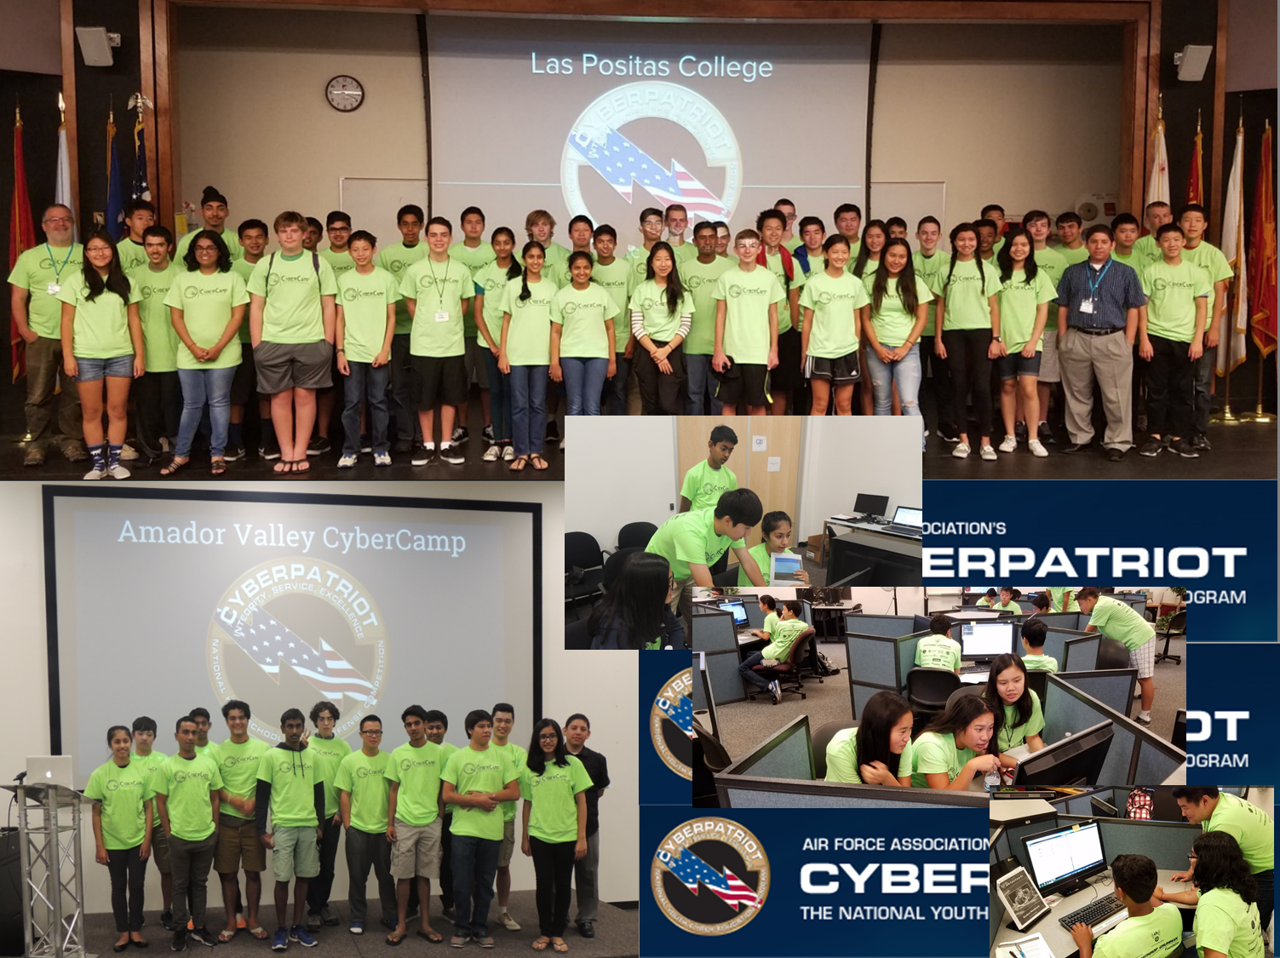

Slide 54

Bay Area Summer Cyber Camp Schedule
June 26 - 30 @ Las Positas and San Jose City College
July 17 - 21 @ Solano, Cabrillo, and Monterey Peninsula College
July 24 - 28 @ Gavilan, Foothill College, and Santa Rosa JC
July 31 - Aug 4 @ CCSF, Merritt and Diablo Valley College
Professional Development: Attend the train-the-trainer faculty development session for interested coaches and mentors scheduled for June 19 - 23 at Cabrillo College in Aptos. This week-long training will prepare coaches and mentors to support a Cyberpatriot program in their school or district.

Slide 55
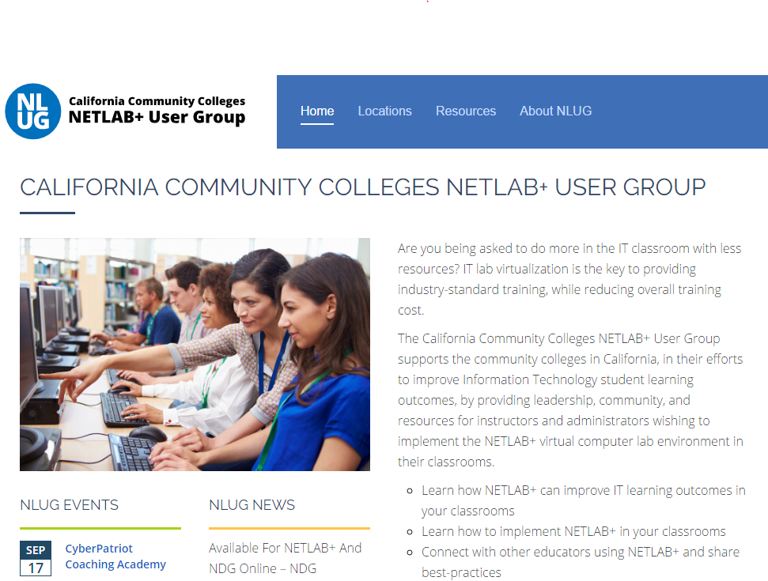
http://cccnetlabsug.org/

Slide 56
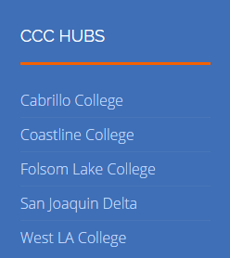
http://cccnetlabsug.org/

Slide 57


State of CA Apprenticeship Program Details
Pre-Reqs, Core & Schedule

Slide 58
Community College IT Model Curriculum
Notes:
C-ID process and Transfer Model Curriculum

Slide 59
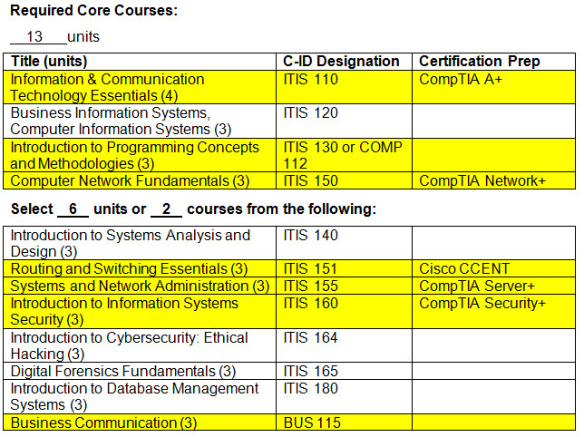
Information Technology - Model Curriculum
Notes:
Resulting ICT Model Curriculum Developed

Slide 60
How It Works
Identify qualified apprentices: new employees and incumbent workers
  3 Pre-req classes required for acceptance into the program:
    IT Essentials } A+
    CCNA Introduction To Networks
    CCNA Routing & Switching Essentials
Civil Service/other exam as part of app process for new employees
Pilot Cohort of 20 begins on July 1, 2017
Second Cohort of 30 begins on January 2018
Program schedule:
  Monday – Thursday OJT
  Course work – Evenings and on-line
  Fridays – @ the State Training Center for Lab and Mentored Study Hall
CCENT

